Slide 1
Computer System Architecture and Organisation (CSC 310)
Reduced Instruction Set Computers (RISCs) and CISCs
D. OKOJIE
23_05_2023
_Please go to slide 30 for beginning of today’s Lecture (Lecture 8)…!!!
CHAPTER 10
Fundamentals of Computer Organisation and Architecture by Mostafa Abd-El-Barr and Hesham El-Rewini

Slide 2
Intro.
These machines represent a noticeable shift in computer architecture paradigm
This paradigm promotes simplicity rather than complexity
RISC approach enhances most frequent and most time consuming operations efficiency

Slide 3
RISC/CISC Evolution Cycle
RISCs stands for Reduced Instruction Set Computers
Architectures that can execute as fast as one instruction per clock cycle
First RISC machine, the IBM 801 minicomputer
This paradigm promotes simplicity in computer architecture design. In particular, it calls for going back to basics rather than providing extra hardware support for high-level languages. This paradigm shift relates to what is known as the semantic gap, a measure of the difference between the operations provided in the high-level languages (HLLs) and those provided in computer architectures.

Slide 4
…RISC/CISC Evolution Cycle
It is recognised that the wider the semantic gap, the larger the number of undesirable consequences
(a) execution inefficiency
(b) excessive machine program size
(c) increased compiler complexity
Because of these expected consequences, the conventional response of computer architects has been to add layers of complexity to newer architectures.
These include increasing the number and complexity of instructions together with increasing the number of addressing modes.
The architectures resulting from the adoption of this “add more complexity” are now known as Complex Instruction Set Computers (CISCs).

Slide 5
…RISC/CISC Evolution Cycle
However, it soon became apparent that a complex instruction set has a number of disadvantages.
These include:
a complex instruction decoding scheme;
an increased size of the control unit; and
increased logic delays.
These drawbacks prompted a team of computer architects to adopt the principle of “less is actually more.” A number of studies were then conducted to investigate the impact of complexity on performance.
These are discussed below:

Slide 6
RISCs Design Principles
A computer with the minimum number of instructions has the disadvantage that a large number of instructions will have to be executed in realizing even a simple function.
This will result in a speed disadvantage. On the other hand, a computer with an inflated number of instructions has the disadvantage of complex decoding and hence a speed disadvantage.
It is then natural to believe that a computer with a carefully selected reduced set of instructions should strike a balance between the above two design alternatives.

Slide 7
…RISCs Design Principles
To archive a carefully reduced instruction set, we look at:
(a) operations that are most frequently performed during execution of typical (benchmark) programs
(b) operations that are most time consuming
(c) the type of operands that are most frequently used
A careful look at the estimated percentage of operations performed reveals that…
assignment statements;
conditional branches; and
procedure calls
constitute about 90% of the total operations performed, while other operations, however complex they may be, make up the remaining 10%

Slide 8
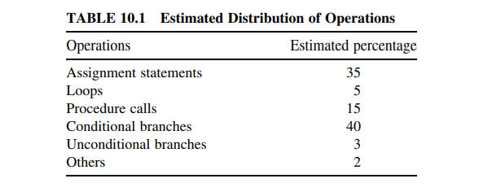
Estimated Distribution of Operations

Slide 9
The above observations about typical program behaviour have led to the following conclusions:
1. Simple movement of data (represented by assignment statements), rather than complex operations, are substantial and should be optimised.
2. Conditional branches are predominant and therefore careful attention should be paid to the sequencing of instructions. This is particularly true when it is known that pipelining (the process of storing and prioritising computer instructions that the processor executes) is indispensable to use.
3. Procedure calls/return are the most time-consuming operations and therefore a mechanism should be devised to make the communication of parameters among the calling and the called procedures cause the least number of instructions to execute.
A prime candidate for optimisation is the mechanism for storing and accessing local scalar variables.

Slide 10
Other observations:
Complex operations such as long division represent only a small portion (less than 2%) of the operations performed during a typical computation. One then should ask the question: how can we achieve that?
The answer is by:
(a) keeping the most frequently accessed operands in CPU registers and
(b) minimising the register-to-memory operations

Slide 11
The above two principles can be achieved using the following mechanisms:
1. Use a large number of registers to optimise operand referencing and reduce the processor memory traffic.
2. Optimise the design of instruction pipelines such that minimum compiler code generation can be achieved (see Chapter 8).
3. Use a simplified instruction set and leave out those complex and unnecessary instructions

Slide 12
The following two approaches were identified to implement the above three mechanisms.
1. Software approach. Use the compiler to maximise register usage by allocating registers to those variables that are used the most in a given time period (this is the philosophy adopted in the Stanford MIPs machine).
2. Hardware approach. Use ample CPU registers so that more variables can be held in registers for larger periods of time (this is the philosophy adopted in the Berkeley RISC machine). The hardware approach necessitates the use of a new register organisation, called overlapped register window.
This is explained below.

Slide 13
OVERLAPPED REGISTER WINDOWS
The main idea behind the use of register windows is to minimise memory accesses
In order to achieve that, a large number of CPU registers are needed.
For example, the number of CPU general-purpose registers available in the original SPARC machine (one of the earliest RISCs) was 120.
However, it is desirable to have only a subset of these registers visible at any given time and to have them addressed as if they were the only set of registers available

Slide 14
…OVERLAPPED REGISTER WINDOWS stopped on 09-05-2023
Therefore, CPU registers are divided into multiple small sets, each assigned to a different procedure.
A procedure call will automatically switch the CPU to use a different fixed-size window of registers.
In order to minimise the actual movement of parameters among the calling and the called procedures, each set of registers is divided into three subsets:
parameter registers;
local registers; and
temporary registers.
When a procedure call is made, a new overlapping window will be created such that the temporary registers of the caller are physically the same as the parameter registers of the called procedure.

Slide 15
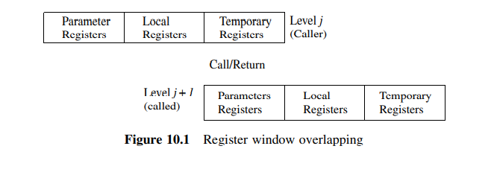
Registers windows

Slide 16
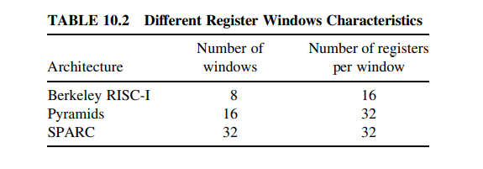
Different Register Windows Characteristics

Slide 17
…Register Windows Characteristics
In addition, a set of a fixed number of CPU registers are identified as global registers and are available to all procedures.
For example, references to registers 0 through 7 in the SPARC architecture refer to unique global registers, and references to registers 8 through 31 indicate registers in the current window.
The current window is pointed to using what is normally called the current window pointer (CWP).
Upon having all windows filled, the register window wraps around, thus acting like a “circular buffer.” Table 10.2 shows the number of windows and the window size for a number of architectures.
It should be noted that a study was conducted in 1985 to find out the impact of using register window on the performance of the Berkeley RISC.
In this study, two versions of the machine were studied.
The first is designed with register windows and
the second was a hypothetical Berkeley RISC implemented without windows.
The results of the study indicated a decrease by a factor of 2 to 4 (depending on specific benchmark) in the memory traffic due to the use of register windows

Slide 18
RISCs VERSUS CISCs
The choice of RISC versus CISC depends totally on the factors that must be considered by a computer designer.
These factors include:
1 size,
2 complexity, and
3 speed.
A RISC architecture has to execute more instructions to perform the same function performed by a CISC architecture.

Slide 19
RISC
To compensate for this drawback,
RISC architectures must use the chip area saved by not using complex instruction decoders in providing
a large number of CPU registers,
additional execution units, and
instruction caches.
The use of these resources leads to a reduction in the traffic between the processor and the memory.

Slide 20
CISC
On the other hand,
a CISC architecture with a richer and more complex instructions, will require;
a smaller number of instructions than its RISC counterpart.
However, a CISC architecture requires a complex decoding scheme and hence is subject to logic delays.
It is therefore reasonable to consider that the RISC and CISC paradigms differ primarily in the strategy used to trade off different design factors.

Slide 21
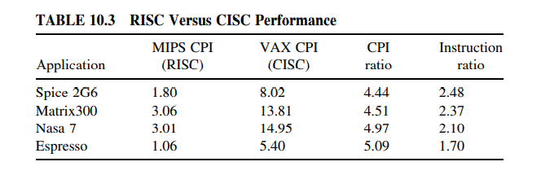
RISC vs CISC Performance

Slide 22
… RISC vs CISC Performance
Increasing the number of CPU registers could very much improve the performance of a CISC machine.
It is worth mentioning at this point that the following set of common characteristics among RISC machines
1. Fixed-length instructions
2. Limited number of instructions (128 or less)
3. Limited set of simple addressing modes (minimum of two: indexed and PC-relative)
4. All operations are performed on registers; no memory operations
5. Only two memory operations: Load and Store

Slide 23
… RISC vs CISC Performance
6. Pipelined instruction execution
7. Large number of general-purpose registers or the use of advanced compiler technology to optimize register usage
8. One instruction per clock cycle
9. Hardwired control unit design rather than microprogramming

Slide 24
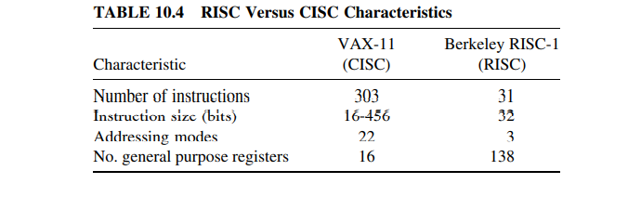
TABLE 10.4 RISC Versus CISC Characteristics

Slide 25
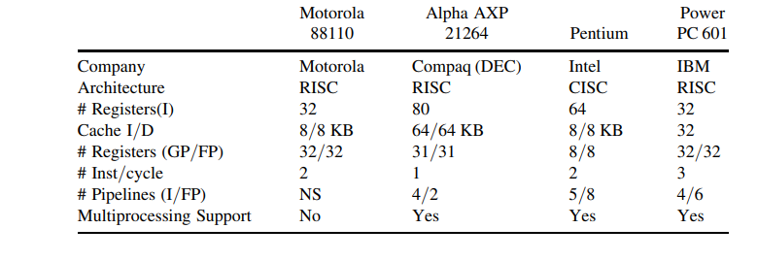
Summary of Features of a Number of RISC and a CISC
TABLE 10.5

Slide 26
PIONEER (UNIVERSITY) RISC MACHINES
In this section, we present brief descriptions of the main architectural features of two pioneer university-introduced RISC machines.
The first machine is the Berkeley RISC and
the second is the Stanford MIPS machine.
These machines are presented as a means to show how original RISC machines look and also to make you appreciate the advances made in RISC machines development since their inception.

Slide 27
The Berkeley RISC
There are two Berkeley RISC machines: RISC-I and RISC-II
Unless otherwise mentioned, the focus here will be on RISC-I in our discussion.
RISC is a 32-bit LOAD/STORE architecture
There are 138 32-bit registers R0 –R137 available to the users
The first ten registers R0 –R9 are global registers (seen by all procedures).
Register R0 is used to synthesize addressing modes and operations that are not directly available on the machine.
Registers R10 –R137 are divided into an overlapping register window scheme with 32 registers visible at any instant.
A 5-bit variable, called current window pointer (CWP) is used to point to the current register set.
All RISC instructions occupy a full word (32 bits).

Slide 28
…The Berkeley RISC
The RISC instruction set is divided into four categories.
These are:
1. ALU (a total of 12 instructions),
2. Load/Store (a total of 16 instructions),
3. Branch & Call (a total of seven instructions), and
4. Special instructions (a total of four instructions).

Slide 29


Some examples of the RISC instructions are:

Slide 30
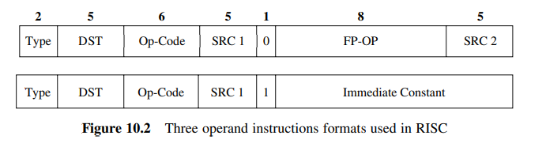
Three operand instructions formats used in RISC _stopped on 16-05-2023 _Beginning of Lecture 8… 23-05-2023!!!

Slide 31
Three operand instructions formats used in RISC
All arithmetic and logical instructions have three operands and have the form:
Destination: = source1 op source2 (Figure 10.2).
The LOAD and STORE instructions may use either of the indicated formats with DST being the register to be loaded or stored.
The low order 19 bits of the instructions are used to determine the effective address
Instructions load and store 8-, 16-, 32-, and 64-bit quantities into 32-bit registers.
Two methods are provided for calling procedures. The CALL instruction uses a 30-bit PC relative offset (Fig. 10.3).

Slide 32
Stanford MIPS (Microprocessor Without Interlock Pipe Stages)
MIPS is a 32-bit pipelined LOAD/STORE machine.
It uses:
a five-stage pipeline consisting of Instruction Fetch (IF),
Instruction Decode (ID),
Operand Decode (OD),
Operand Store/Execution (OS/EX), and
Operand Fetch (OF)
The first three stages perform respectively;
1. instruction fetch,
2. instruction decode, and
3. operand fetch
MIPS uses a mechanism called pipeline interlock in order to prevent an instruction from continuing until the needed operand is available.
Unlike the Berkeley RISC, MIPS has a single set of sixteen 32-bit general purpose registers.

Slide 33
… Stanford MIPS (Microprocessor Without Interlock Pipe Stages)
Four addressing modes are used in MIPS.
These are;
1. immediate,
2. indexed,
3. based with offset, and
4. base shifted.
Four instruction groups were identified in MIPS.
These are;
1. ALU,
2. Load/Store,
3. Control, and
4. Special instructions.
A total of 13 ALU instructions were provided. These include all register-to-register two- or three operand formats (Fig. 10.5).
A total of 10 LOAD/STORE instructions were provided. They use 16 or 32 bits. In the latter case, indexed addressing is used by adding a 16-bit signed constant to a register using the second format in Figure 10.5.
A total of six control flow instructions were provided. These include jumps, relative jumps, and compare instructions

Slide 34
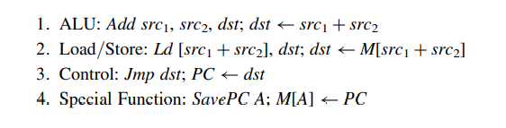
… Stanford MIPS (Microprocessor Without Interlock Pipe Stages)
Only two special flow instructions were provided.
They support procedure and interrupt linkage.
Some examples of MIPS instructions are:

Slide 35
… Stanford MIPS (Microprocessor Without Interlock Pipe Stages)
MIPS does not provide direct support for floating-point operations.
Floating point operations are to be done by a specialized coprocessor.
Surprisingly, non-RISC instructions such as MULT and DIV were included and they use special functional units.
The contents of two registers can be multiplied or divided and the 64-bit product is kept in two special registers LO and HI.
Procedure call can be made through the JUMP instruction shown in Figure 10.6.
The instruction uses a 26-bit jump target address.
The MIPS virtual address is 32 bits long, thus allowing for up to four Gwords virtual address space.
A virtual address is divided into a 20-bit virtual page number and a 12-bit offset within the page.
The actual implementation of MIPS was restricted by packaging constraints allowing only 24 address pins; that is, the actual physical address space is 2^24 = 16 Mwords (32 bits each).
A support for off-chip TLB for address translation is provided. Hence, MIPS organisation is as shown in Figure 10.7.

Slide 36
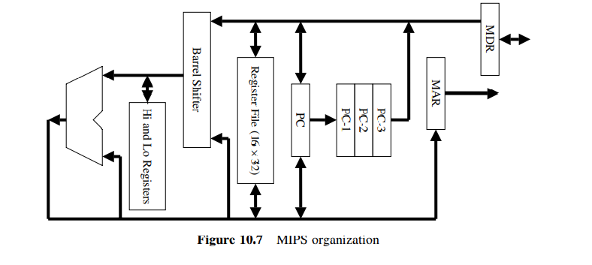
The MIPS organisation is shown in Figure 10.7

Slide 37
EXAMPLE OF ADVANCED RISC MACHINES
In this section, an introduction of two representative advanced RISC machines is made.
However, the emphasis in this coverage will be on
the pipeline features and
the branch handling mechanisms used.

Slide 38
Compaq (Formerly DEC) Alpha 21264
Alpha 21264 (EV6) is a third generation Compaq (formerly DEC) RISC superscalar processor.
It is a full 64-bit processor. The 21264 has an 80-entry integer register file and a 72-entry floating-point register file.
It employs a two-level cache.
The L1 data and instruction caches are 64 KB each. They are organized in a two-way set-associative manner.
The L2 data cache can be 1 to 16 MB (shared by instructions and data) organised by using direct-mapping. The block size is 64 bytes.
The data cache can receive any combination of two loads or stores from the integer execution pipe every cycle.
This is equivalent to having the 64 KB on-chip data cache delivering 16 bytes every cycle, hence twice the clock speed of the processor.

Slide 39
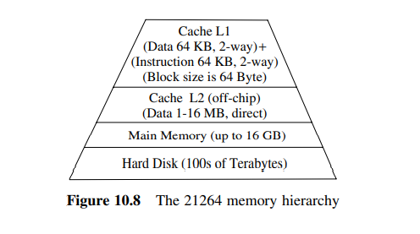
Compaq (Formerly DEC) Alpha 21264
The 21264 memory system can support up to 32 in-flight loads, 32 in-flight stores, and 8 in-flight (64 byte) cache block fills and 8 cache misses.
As shown in Figure 10.8, it has a 64 KB, two-way set-associative cache (both instruction and data).
It can also support up to two out-of-order operations.
Figure 10.8 The 21264 memory hierarchy

Slide 40
10.6.2. The Alpha 21264 Pipeline
The Alpha 21264 instruction pipeline is shown in Figure 10.9 below.
It consists of SEVEN stages.
These are:
the Fetch,
Slot Assignment,
Rename,
Issue,
Register Read,
Execute, and
Memory stages.

Slide 41
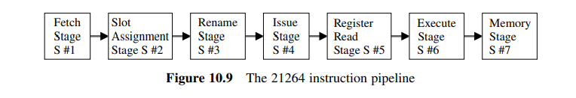
Figure 10.9 The 21264 instruction pipeline

Slide 42
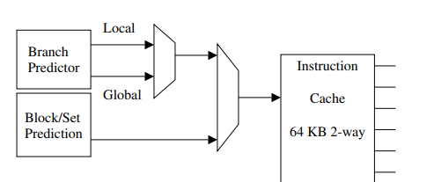
The Alpha 21264 Pipeline
The fetch stage can fetch and execute up to four instructions per cycle.
A block diagram of the fetch stage is shown in Figure 10.10.
This stage uses a unique “block and set” prediction technique.
Figure 10.10. The 21264 fetch stage

Slide 43
The Alpha 21264 Pipeline
According to this technique, both the locations of the next four instructions and the set (there are two sets) in which they are located, are predicted.
The “block and set” prediction technique combines the speed advantages of a direct-mapped cache with the lower miss ratio of a two-way set-associative cache.
This technique achieves more than an 85% hit ratio.
The misprediction penalty is a single cycle.
The 21264 uses speculative branch prediction.
Branch prediction in the 21264 is a two-level scheme.
It is based on the observation that branches exhibit both local and global correlation.
Local correlation makes use of the branch’s past behaviour.
Global correlation, on the other hand, makes use of the past behaviour of all previous branches.

Slide 44
SUN UltraSPARC III
The UltraSPARC® III is a high-performance superscalar RISC processor that implements the 64-bit SPARC® -V9 RISC architecture.
There exist a number of implementations of the SPARC III processor.
These include
the UltraSPARC IIIi and
the UltraSPARC III Cu.
The UltraSPARC III is a third generation 64-bit SPARCw RISC microprocessor.
It supports a 64-bit virtual address space and a 43-bit physical address space.
The UltraSPARC III employs a multilevel cache architecture.
The UltraSPARC IIIi supports a 1 MB four-way set-associative, unified instruction/data on chip L2 cache.
A cache block size of 64 bytes is used in the UltraSPARC IIIi.
While the UltraSPARC III Cu architecture supports a 1, 4, or 8 MB two-way set-associative, unified instruction/data external cache.
Cache block size in the UltraSPARC III Cu varies between 64 bytes (for the 1 MB cache) to 512 bytes (for the 8 MB cache), see Figure 10.13.

Slide 45
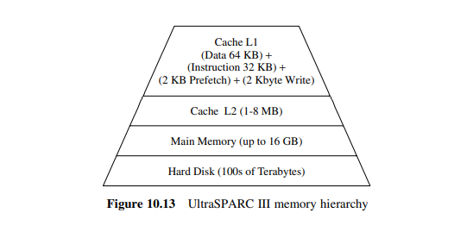
Figure 10.13 UltraSPARC III memory hierarchy

Slide 46
…SUN UltraSPARC III
The UltraSPARC III uses two instruction TLBs that can be accessed in parallel and three data TLBs that can be accessed in parallel.
The two instruction TLBs are organised in a 16-entry fully associative manner to hold entries for 8 KB, 64 KB, 512 KB, and 4 MB page sizes.
A 128-entry two-way set-associative TLB is used exclusively for 8 KB page sizes.
The three data TLBs are organised in a 16-entry associative manner for 8 KB, 64 KB, 512 KB, and 4 MB page sizes and two 512-entry two-way set-associative TLBs that can be programmed to hold any one page size at a given time.
The Ultra SPARC III uses a write-allocate, write- back cache write policy. The Ultra SPARC III pipeline has been covered in Chapter 9 (pages 203 –207).
On a final note, it should be mentioned that the Ultra SPARC III has been designed to support a one-to-four way multiprocessing.
For this purpose, it uses the JBus, which supports a small-scale multiprocessor system.
The JBus is capable of delivering the high bandwidth needed for networking and embedded systems applications.
Through the JBus, processors can attach to a coherent shared bus with no needed glue logic, see Figure 10.14.

Slide 47
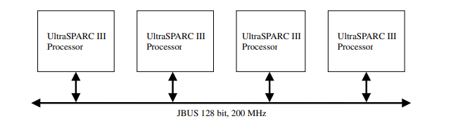
Figure 10.14 A four-way Ultra SPARC III multiprocessor configuration
Figure 10.14. four-way UltraSPARC III multiprocessor

Slide 48
Thank You
Questions?...

